Slide 1
What does she look like?
She has many colorful braids.
She has big, black eyes.
She has a round nose.
She has a sexy, small, Cupid’s Bow mouth.
She’s a famous singer from Hong Kong, and a tutor of The Rap of China.

Slide 3
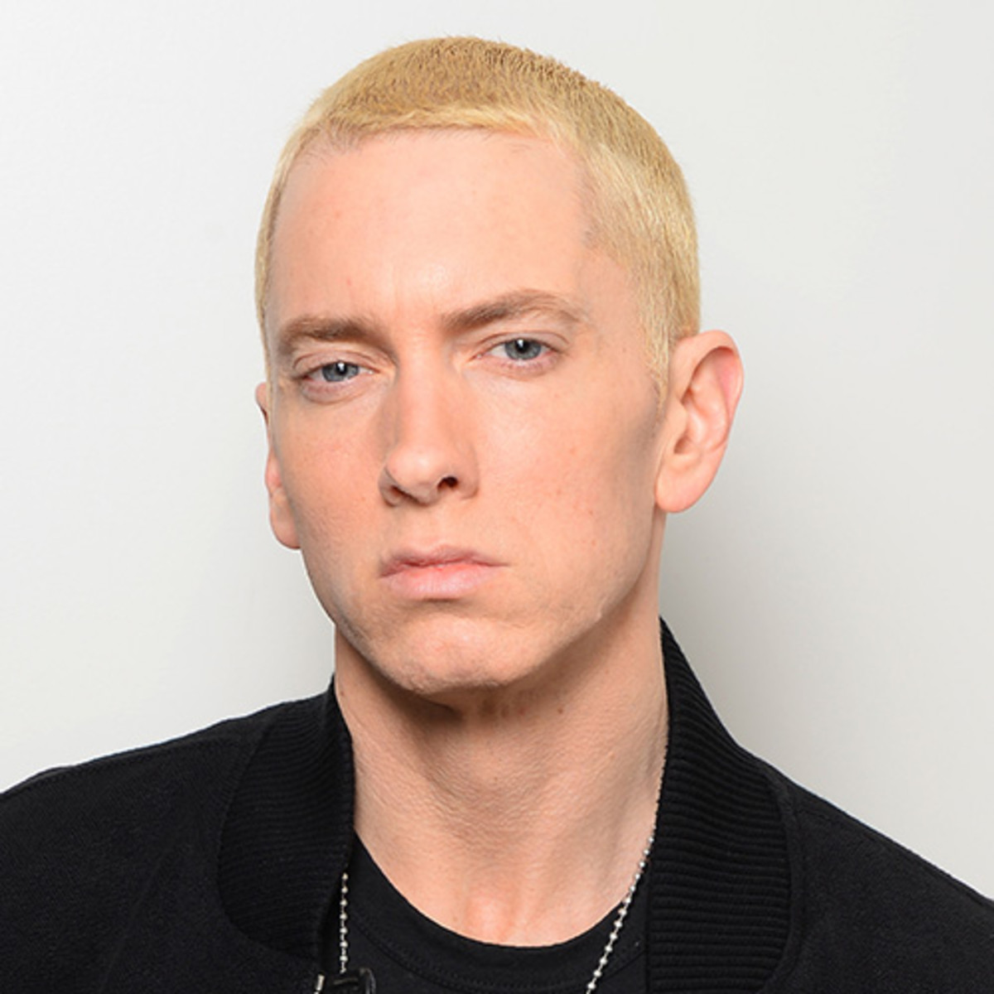
What does he look like?
He has a blond crew cut.
He has big, blue eyes.
He has a pointy nose.
He has a natural mouth.
He has big ears.
He’s a popular rapper, a music producer, and an actor from America .

Slide 6
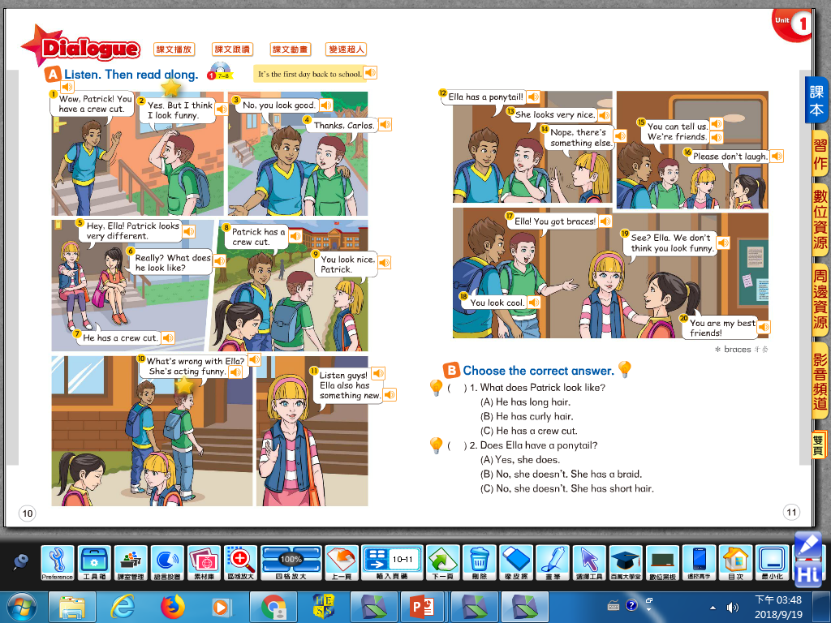

Slide 7
1. What does Patrick look like?
He has a crew cut.

Slide 8
2. Does Ella have a ponytail?
Yes, she does. She has a ponytail.

Slide 9
3. What’s something new about Ella?
She has braces.

Slide 10
4. Why they four can be real friends?
They don’t laugh at friends. Respect each other’s differences.

Slide 11
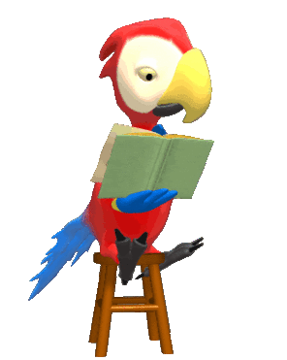
Copy the intonation of CD!

Slide 12
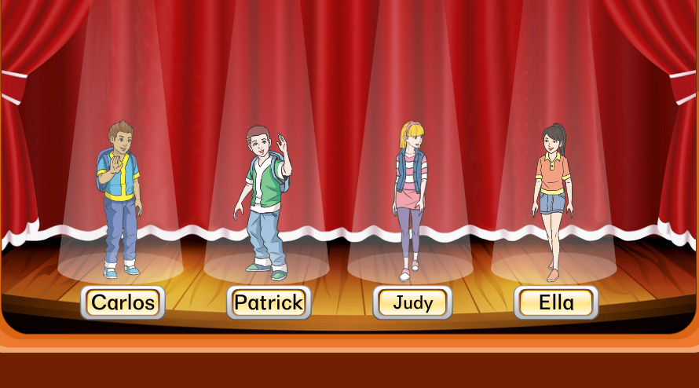
Role Play

Slide 13
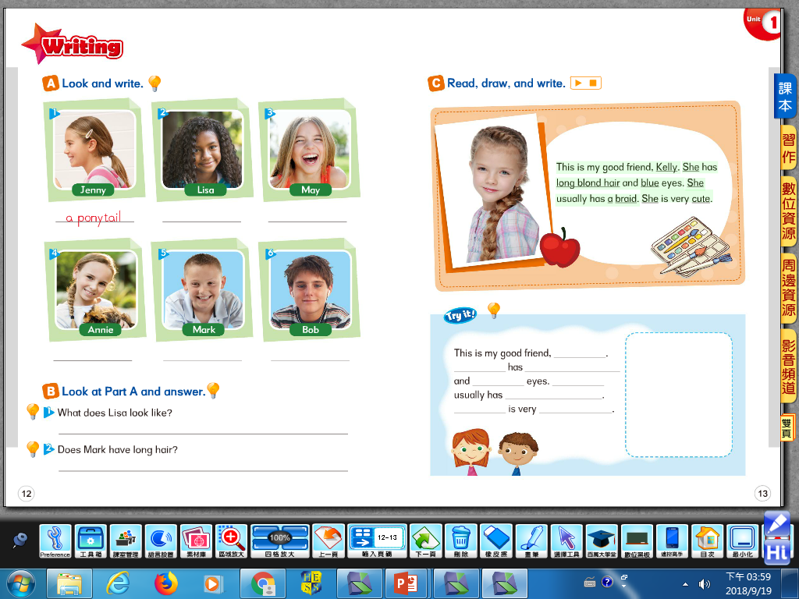

Slide 14
【本週英語作業】
聽:CD Unit 1全。
背:Unit 1單字(包含上課補充的字彙)，下週英語課小考。
No writing homework this week! Happy Moon Festival!!!

Slide 15
Where are they from?

Slide 16
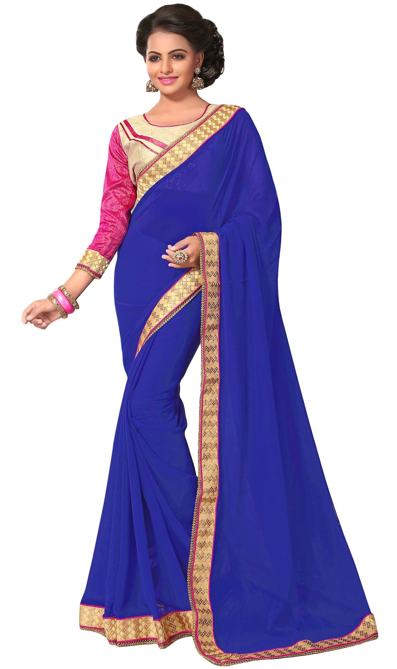

Slide 17
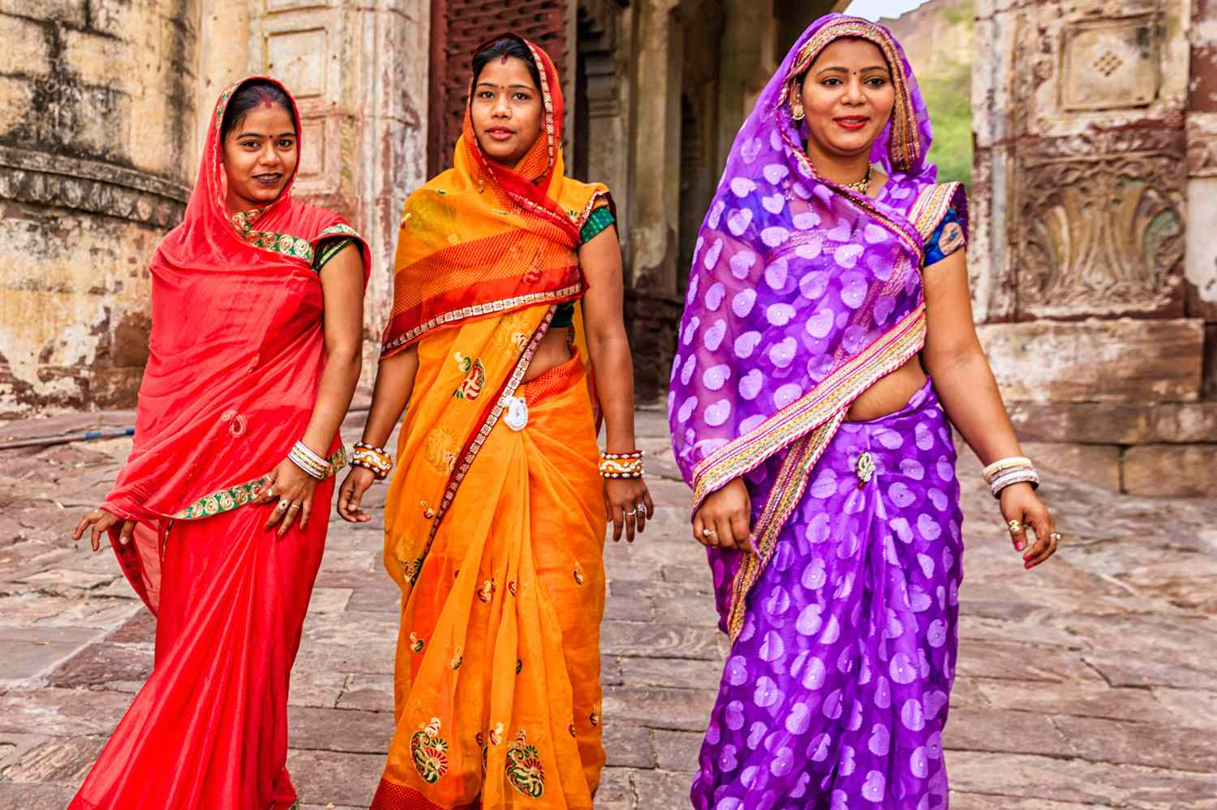
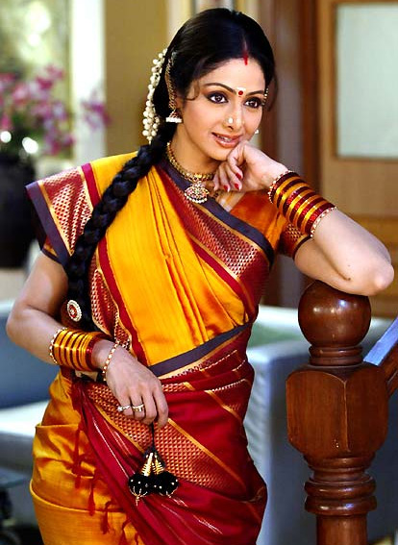
sari/ saree紗麗

Slide 18
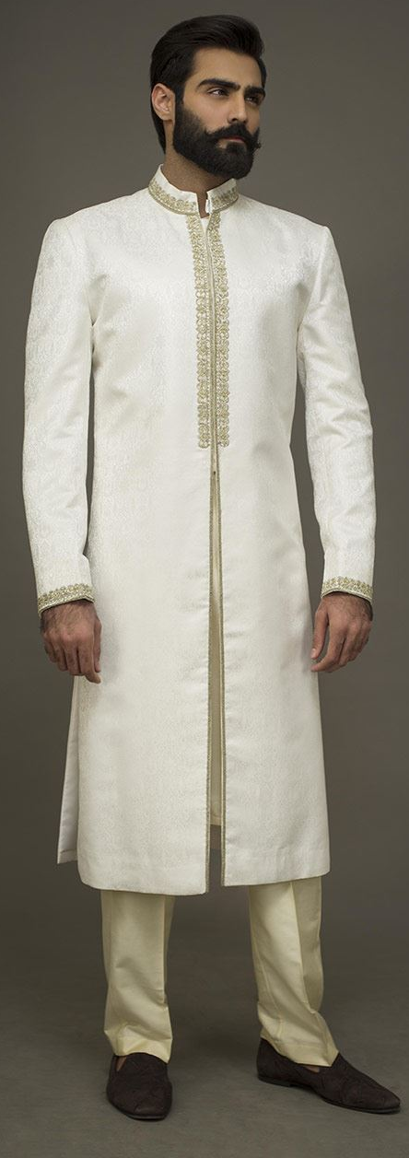
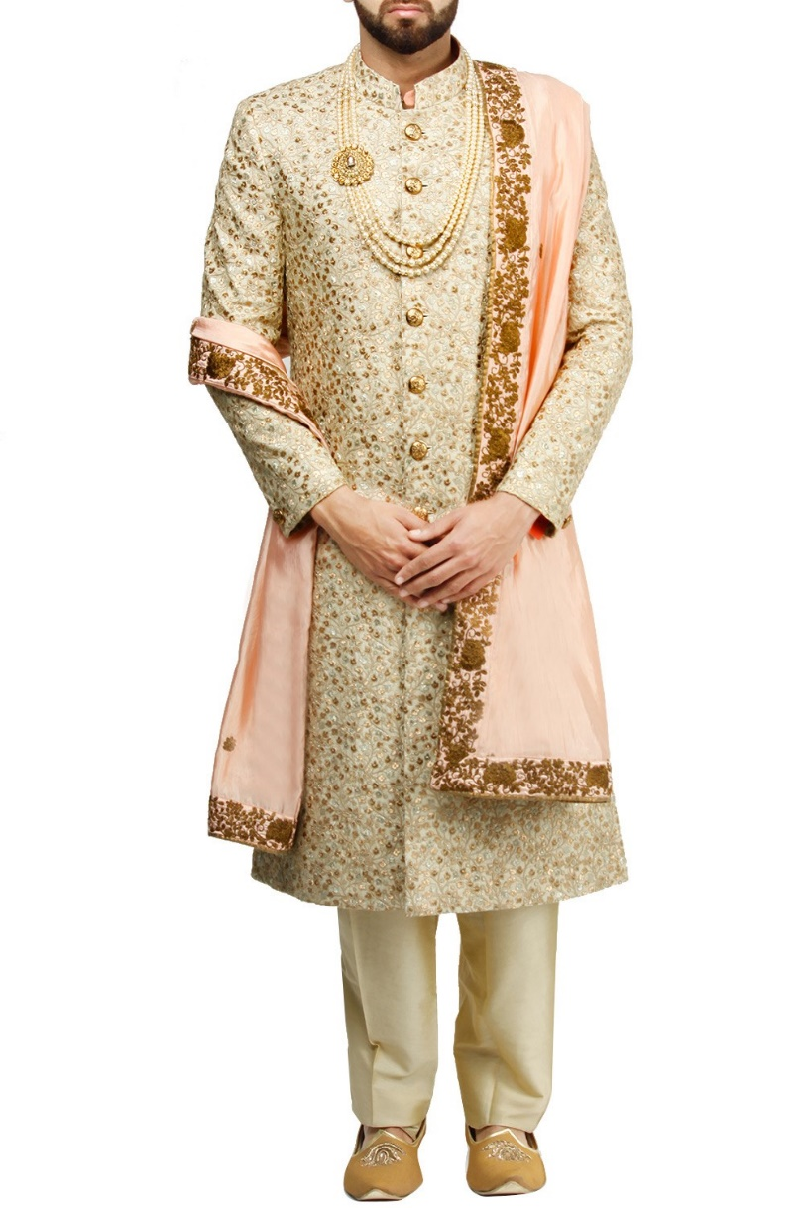
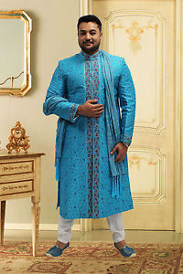
sherwani印度男服

Slide 23
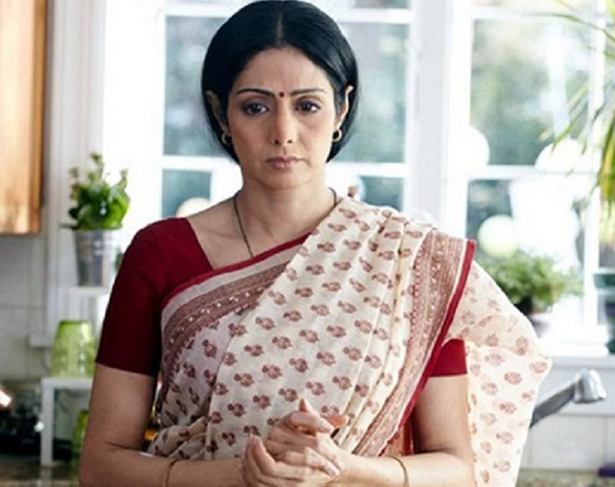
Shashi is a housewife who makes and sells laddoos as a home-run business. Her husband and daughter take her for granted, mock her poor English skills, and generally treat her with disrespect, making Shashi feel negative and insecure.

Slide 24
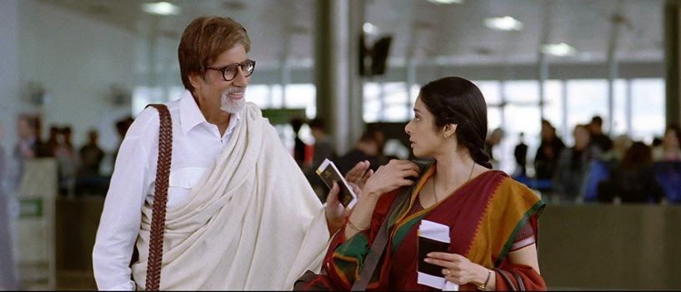
Shashi's older sister Manu, who lives in New York, invites Shashi's family to her daughter Meera's wedding to Kevin. It is decided that Shashi will go to New York alone five weeks before the wedding to help Manu organize.

Slide 25
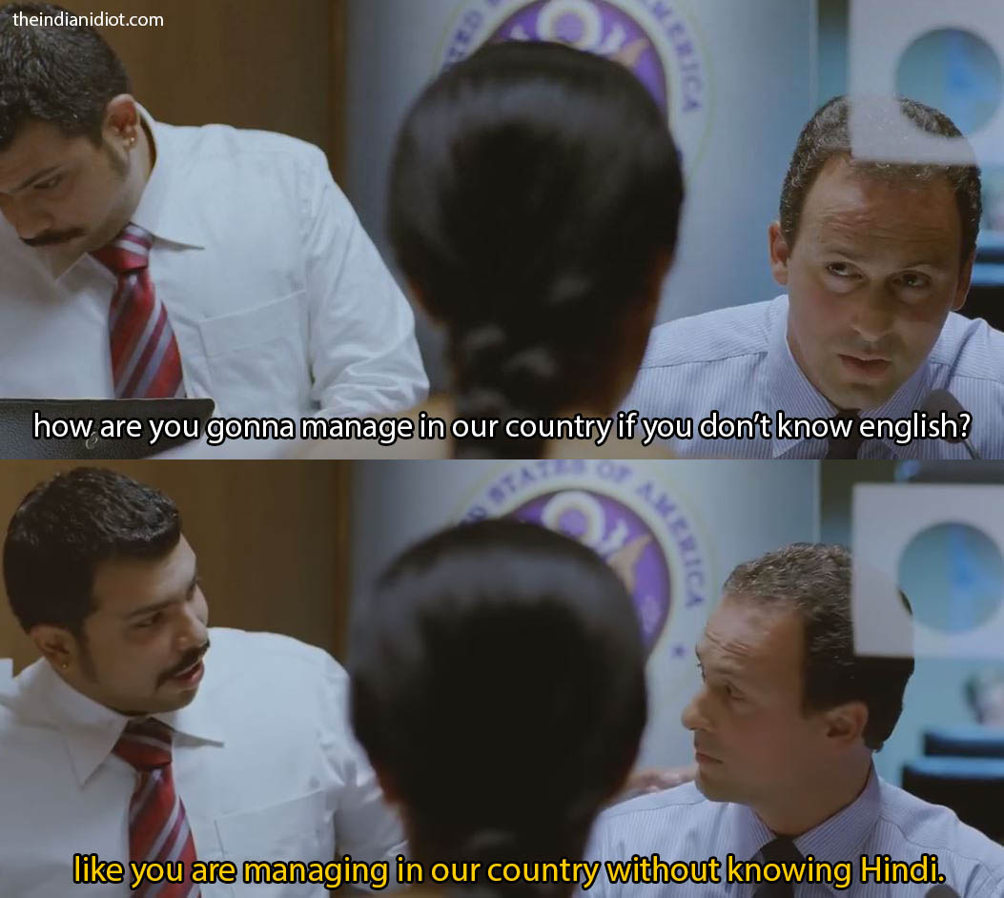

Slide 26
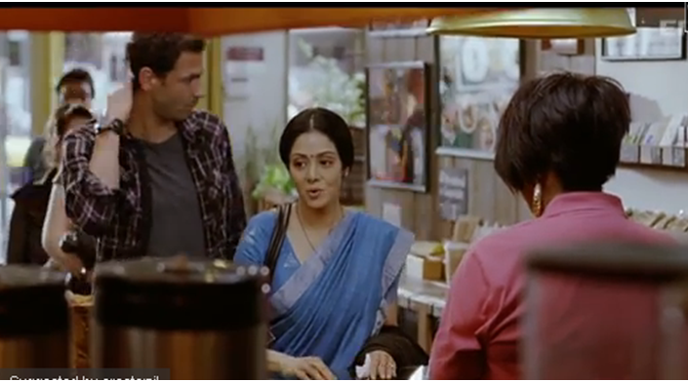
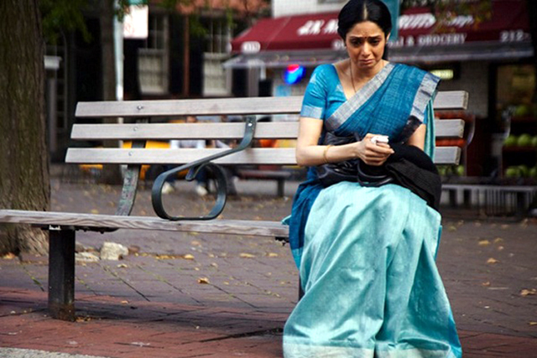
While Shashi is in New York, she has a horrible experience at a cafe due to her inability to communicate in English. She is comforted by a French chef Laurent who happened to be queuing up behind her at the cafe.

Slide 27
